Slide 1

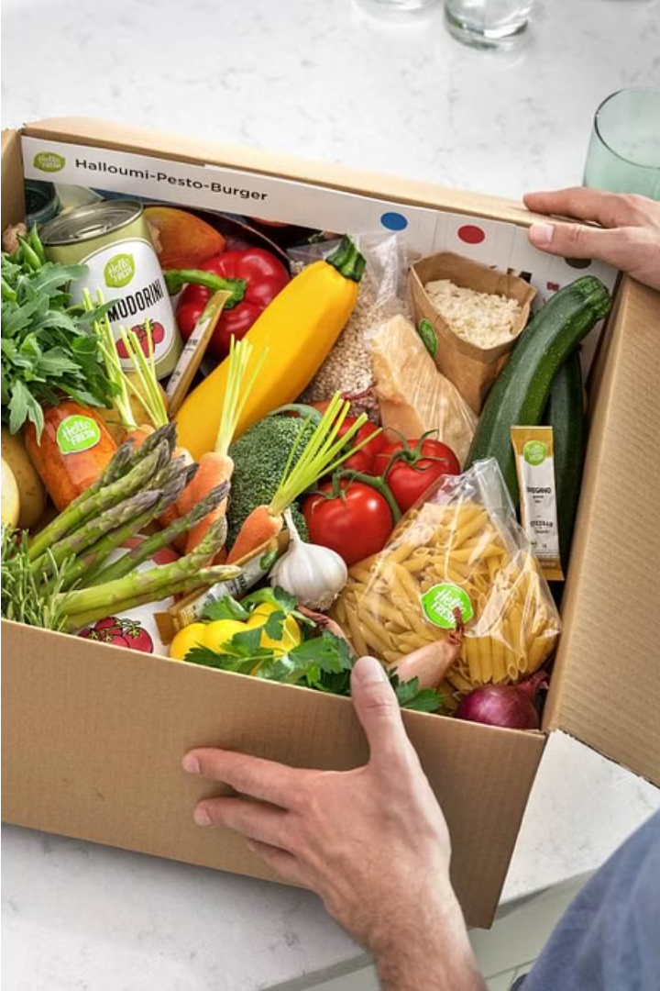
The purpose of this project is to provide an online food delivery system. Online Food ordering system is a process in which one can order various foods and beverages from some local restaurant and hotels through the use of internet, just by sitting at home or any place. And the order is delivered to the told location. Nowadays everyone is having busy schedule whether it is urban area or rural. But talking specifically about the urban areas and deeply about the big cities, people out there are so busy in their life that they don’t get enough of time to have their meals properly. As these days women are no less than men, in any field. So in big cities even wives are working women, therefore mostly the small families manage to have their food ordered from somewhere, as they lack time. Not only this is the case, if we talk about the children in the modern era they like only fast food or something from the outside. But they ignore eating homemade meals. So food ordering system these days has one of the fastest growing market, though being a new idea. In this project we have developed something like the same to earn from and serve the nation in a much better way possible. Nowadays, people are more regular to dine-in at restaurant for their meals. The online food ordering system provides convenience for the customers that are nothing special but the general busy people of the society. It overcomes the demerits of the manual hotel or mess system and the old fashioned queuing system. This system enhances the readymade of foods than people. Therefore, this system enhances the speed of getting food in person’s plate and quality and manner of taking the order from the customer. It provides a better communication platform. The user’s details are stored using the electronic media. The online food ordering system provides the menu online and the customers can easily place the order by just clicking the mouse or by touching a button on their smart phones. Also with the food ordering system online, people can easily track their orders, and admin can maintain customer’s database and advance the food delivery system. This food ordering system allows the user to select the desired food items from a list of available menu items provided by the local hotel or restaurant. The user can place orders for the food items of their like from the list. The payment can be made online or pay-on-delivery system. The user’s details are maintained confidential because it maintains a separate account for each user. An id and password is provided for each user. And several encryption techniques have also been used on the server side to protect the card details. Therefore it provides a more secured and safe ordering system.
Introduction to the Online Food Ordering System
In today's fast-paced world, the convenience of online food ordering has become increasingly essential. The online food ordering system provides a seamless and efficient way for customers to browse menus, select their favorite dishes, and have them delivered straight to their doorstep. This innovative platform not only saves time and effort but also offers a wider range of culinary options, catering to diverse dietary preferences and cravings.
a

Slide 2
Benefits of an Online Food Delivery Service
Convenience
Expanded Options
Real-time Tracking
The online food ordering system allows customers to place orders from the comfort of their homes or offices, eliminating the need to physically visit restaurants or make phone calls. This is particularly beneficial for individuals with busy schedules or limited mobility.
The online platform provides access to a vast array of restaurants and cuisines, enabling customers to explore and discover new culinary experiences. This diversity caters to various dietary preferences and taste buds.
Customers can track the status of their orders in real-time, providing them with the peace of mind and the ability to plan their mealtimes effectively.

Slide 3
Key Features of the Online Food Ordering Platform
1
User-friendly Interface
2
Comprehensive Menu Listings
The platform should feature a clean, intuitive, and visually appealing interface that allows customers to navigate through the menu, filter options, and place orders seamlessly.
The platform should provide detailed menu information, including item descriptions, images, and pricing, enabling customers to make informed decisions.
3
Secure Payment Options
4
Real-time Order Tracking
The platform should offer a range of secure payment methods, such as credit/debit cards, digital wallets, and cash on delivery, to cater to the preferences of a diverse customer base.
Customers should be able to track the status of their orders in real-time, from the moment the order is placed to its delivery, providing them with transparency and peace of mind.

Slide 4
Target Audience and User Demographics
Urban Professionals
Millennials and Gen Z
The primary target audience for the online food ordering system is urban professionals with busy lifestyles, who value the convenience and time-saving benefits of having meals delivered to their homes or offices.
Younger generations, such as millennials and Gen Z, are also a key target audience, as they are highly tech-savvy and accustomed to the on-demand nature of online services, including food delivery.
Families and Households
Health-conscious Individuals
Families and households, especially those with young children or elderly members, can greatly benefit from the online food ordering system, as it provides a convenient option for meal planning and delivery.
Individuals with specific dietary requirements or a focus on healthy eating may find the online food ordering system particularly useful, as it allows them to easily access a variety of nutritious meal options.

Slide 5
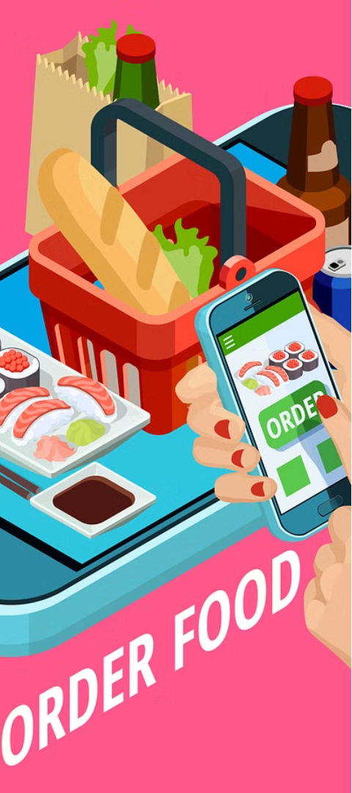

Competitive Analysis and Market Trends
1
Emergence of Dominant Players
The online food delivery market has seen the emergence of several dominant players, such as GrubHub, DoorDash, and Uber Eats, each offering a wide range of restaurant options and leveraging technology to streamline the ordering and delivery process.
2
Expansion of Cuisine Offerings
The market has witnessed a significant expansion of cuisine offerings, with platforms catering to diverse culinary preferences, including ethnic, vegan, and specialized dietary options, to meet the evolving demands of customers.
3
Technological Advancements
The online food delivery industry has embraced technological advancements, such as AI-powered recommendations, voice-enabled ordering, and real-time tracking, to enhance the customer experience and improve operational efficiency.

Slide 6




Technology and Infrastructure Requirements
Mobile App
Point-of-Sale Integration
Delivery Fleet Management
Data Analytics
A user-friendly mobile application that allows customers to browse menus, place orders, and track deliveries on-the-go is a crucial component of the online food ordering system.
Leveraging data analytics to gather insights on customer preferences, order patterns, and operational efficiency can inform strategic decision-making and drive continuous improvements.
Seamless integration with restaurant point-of-sale (POS) systems ensures efficient order processing and inventory management, facilitating a smooth ordering and fulfillment process.
A robust delivery fleet management system, with real-time tracking and optimization capabilities, ensures timely and reliable order delivery to customers.

Slide 7




Revenue Model and Monetization Strategies
Commission-based Model
Subscription-based Fees
Advertising and Sponsorships
Value-added Services
The platform can earn revenue by charging a commission on each order placed through the system, typically a percentage of the total order value.
Offering a premium subscription service that provides additional features, such as exclusive discounts or priority delivery, can generate a recurring revenue stream.
Providing value-added services, such as menu optimization, data analysis, or marketing support to partner restaurants, can diversify the revenue streams.
The platform can monetize by offering advertising opportunities to restaurants and brands, allowing them to reach a targeted customer base.

Slide 8
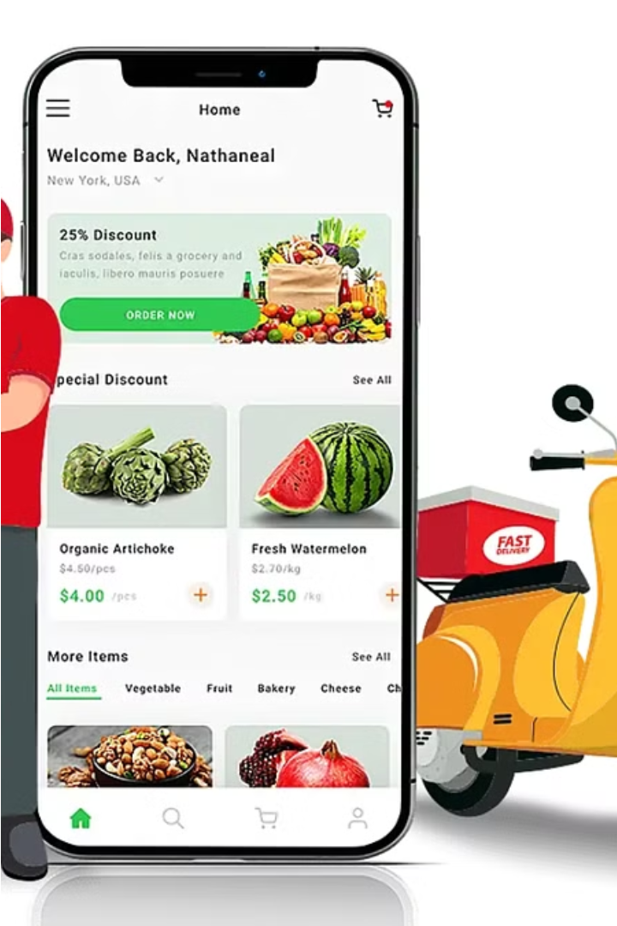
Conclusion and Future Outlook
The online food ordering system has emerged as a game-changer in the food and hospitality industry, offering unparalleled convenience, expanded culinary options, and seamless delivery experiences for customers. As technology continues to evolve and customer preferences shift, the future of this industry holds immense potential, with advancements in areas such as AI-powered personalization, autonomous delivery, and integrated sustainability initiatives. By continuously innovating and adapting to market trends, the online food ordering system can cement its position as a vital and indispensable service, revolutionizing the way people access and enjoy their meals in the years to come.

